Slide 1
Discovery of NDI-101150, A Highly Potent and Selective HPK1 Inhibitor for the Treatment of Cancer, Through Structure-Based Drug Design
Neelu Kaila (on behalf of the HPK1 team)
Nimbus Therapeutics

Slide 2
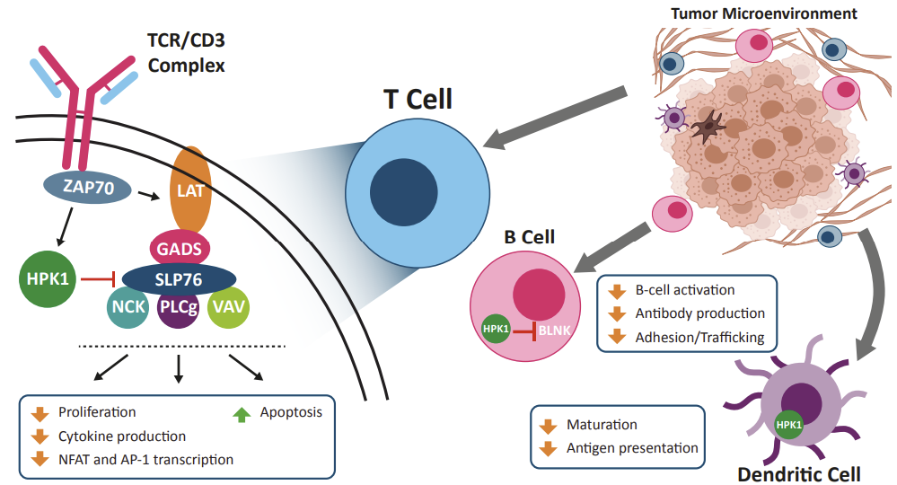
Hematopoietic Progenitor Kinase 1 (HPK1, MAP4K1)
A Compelling Immuno-Oncology Therapeutic Target Due to Role in Broad Multi-Immune Activation
Negative regulator of T cell, B cell, and dendritic cell-mediated immune response^{1,2}
Expression is restricted to hematopoietic cells
Genetically validated target
  HPK1^{-/-} mice have enhanced anti-tumor T-cell response and are resistant to growth of Lewis lung carcinoma^{1,2}
  HPK1 kinase-inactive-knock-in mice show impaired GL261 tumor growth, associated with increased T-cell infiltration^{1,2}
The MAP4K family consists of 6 members with varied and compensatory roles in immune cell signalling and inflammation
MAP4K1 and MAP4K4 are negative regulators and MAP4K3 (GLK) is a positive regulator of the T-cell activation
Key requirements for HPK1 inhibitor design is to get selectivity against
  GLK and kinases involved in the propagation of TCR signalling, such as Src and other STE20-like family of kinases
1. Alzabin S., et al. Cancer Immunology and Immunotherapy 2010, v59: 419-429.
2. Hernandez S., et al. Cell Reports 2018. v25: 80-94.
Notes:
Program collaborators Schrödinger and CRL

Slide 3
A High Degree of HPK1 Inhibitor Selectivity is Required for Cellular On-target Activity
IL-2 induction in primary mouse T cells: Compounds with superior GLK selectivity have improved functional activity compared to those with poor selectivity. Potency alone is not enough to induce immune response you need GLK selectivity
Potent HPK1 inhibitors with poor GLK selectivity
Potent HPK1 inhibitors with good GLK selectivity
Compound 1
Compound 2
Compound 3
Compound 4
Compound | Biochem HPK1 IC₅₀ (nM) @ 1mM ATP | HPK1 cell IC₅₀ (nM) | GLK Biochem selectivity (Fold vs HPK1 @ 1 mM ATP)
1 | 1.7 | 97 | 3
2 | 0.5 | 100 | 5
3 | 2 | 120 | 150
4 | 3 | 93 | 160
EC₅₀s shift to the left (more potent) and the magnitude of IL-2 induction (peak response) increases with improved GLK selectivity
Notes:
Not only potency but GLK selectivity gives desired pharmacology; range of hook effect increases; 1 uM not a concern at relevant human doses. Never reach unbound 1 uM concentration.
Cytokines B Cells (IgG) and dendritic cells.

Slide 4
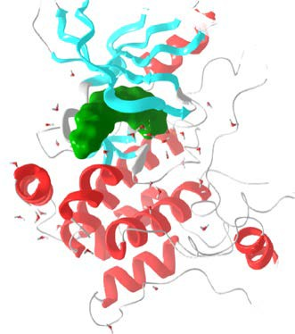
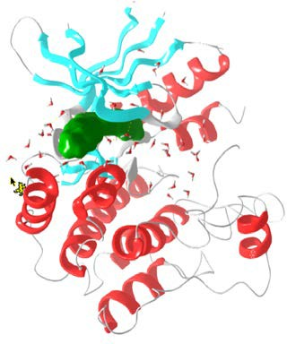
Origins of Nimbus HPK1 Chemical Matter
Virtual Screen
4 Receptor ensemble (3 HPK1 & 1 GLK) co-crystals
Virtual library 11.5 M commercial compounds
Filters used property space, Glide docking, Wscore
14 Hits Identified
Focus:
SAR by catalog
Deprioritized due to poor potency of hits
Nimbus Library Hit
Excellent affinity
Poor Selectivity
FEP/SBDD enabled. Multiple high resolution structures obtained
Focus:
Improve selectivity
Further ADME Profiling
Deprioritized in favor of the lead series due to moderate selectivity
Multiple HPK1/ GLK Proprietary Structures Obtained
Literature-Based Hit Generation
Identify known literature compounds with potent HPK1 inhibition - Good affinity, Poor selectivity
Focus:
Obtain an HPK1 co-crystal to build selectivity
Deprioritzed as we could not generate co-crystal with HPK1
Knowledge-Based Hit Generation
Good affinity & selectivity
FEP/SBDD enabled
Lead Series
Focus:
ADME Optimization
Prioritized due to excellent selectivity against GLK
Notes:
Only read headings.

Slide 5
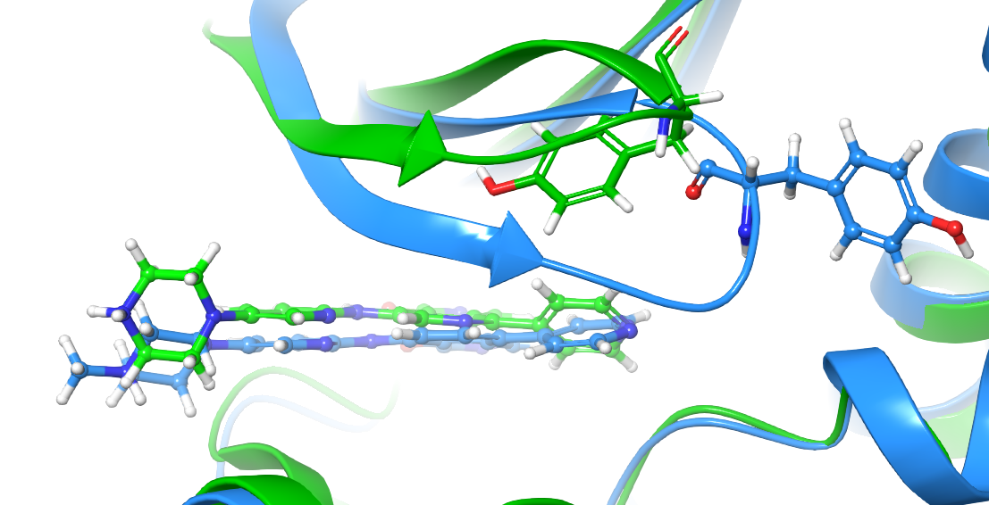
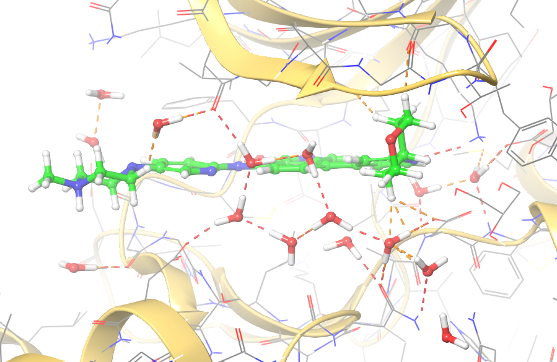
Knowledge Based Hit Generation
Literature
Nimbus Hit
Goal: Overlap of Tyr with C-1 substituent to improve HPK1 potency
HPK1:Compound 7 / Compound 8
Combine
Compound 5
*HPK1 IC₅₀ = 14 nM
GLK Sel = 3X
Tyk2 NA
P-Loop conformation affects orientation of identical residues
-Tyr 27 away from binding pocket in GLK: Compound 8
-Tyr 28 in binding pocket in HPK1:1 Compound 7
Compound 6
*HPK1 IC₅₀ = 4 nM
GLK Sel = 0.17X
Tyk2 Sel = 0.14X
Compound 8
*HPK1 IC₅₀ = 98 nM
GLK Sel = 1.4X
Tyk2 NA
Compound 7
*HPK1 IC₅₀ = 70 nM
GLK Sel = 1.3X
Tyk2 NA
2
1
1
Goal: Break the water network to improve selectivity against GLK
GLK:Compound 8 (P-loop up)
New series (aza isoindolinone) identified
- P-loop interacts directly with water network
- GLK structures show highly defined network near C1/C2 vectors
*Assay run at Km ATP

Slide 6
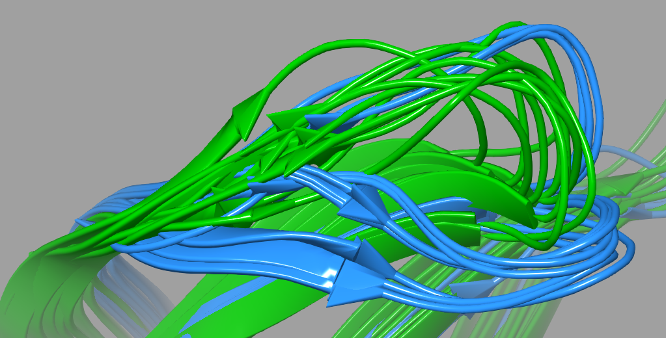
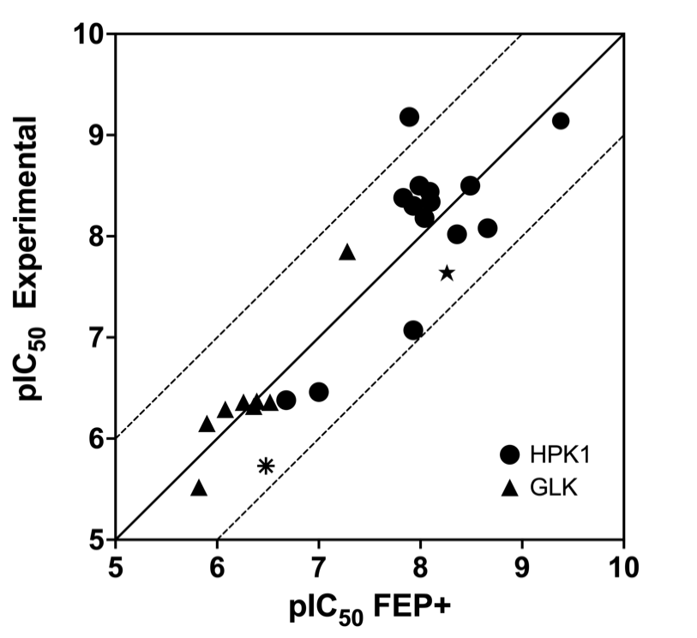
Significant Conformational Flexibility Observed in HPK1 and GLK X-ray Structures
Flexibility of the P-loop creates challenges and opportunities
Due to the dynamic nature of the P-loop use of FEP+ to increase potency and selectivity was challenging
Enhanced flexibility of HPK1 provided a path to selectivity
HPK1
13 Co-crystals (2 constructs)
C-Helix, activation and P-loops take on a wide range of conformations
GLK
31 Co-structures (5 constructs) Soakable system
GLK P-loop alternates between two positions
Overlay of HPK1 P-loop and GLK P-loop from co-crystals with different ligands
Prospective FEP+ predictions for HPK1 and GLK plotted against experimental
High-resolution ligand bound crystal structures facilitated the use of FEP+

Slide 7
Identification of Potent and Selective Bicyclic Series - Target Interaction with Tyr28
4
4
Assay | 9 | 10 | 11 | 12 | 13
HPK1ª IC₅₀ (nM) | 43 | 1.8 | 15 | 0.8 | 2.6
GLK Selectivity^{b} | 1 | 26 | 21 | 74 | 46
Caco-2 P_{app, A-B}^{c} / ER | 5.7 / 14 | 0.6 / 92 | 0.4 / 29 | 26 / 2.8 | --
AChE IC₅₀ (nM) | -- | -- | -- | 26 | >10,000
ªBiochemical potency at 1 mM ATP; ^{b}1 mM ATP; ^{c}10⁻⁶ cm/s
Replacement of monocyclic pyridine with bicyclic aromatic rings improved HPK1 potency and selectivity against GLK
Cross-screening identified acetyl choline esterase (AChE) inhibition as a significant liability for the C-4 piperazine series.
  Compound 12 exhibited human AChE IC₅₀ of 26 nM
Docking in a AChE literature structure showed that piperazine might be making a cation-π interaction with Trp86
  Replacement of the basic piperazine compound 13 removed AChE inhibition (IC₅₀ > 10,000 nM)

Slide 8
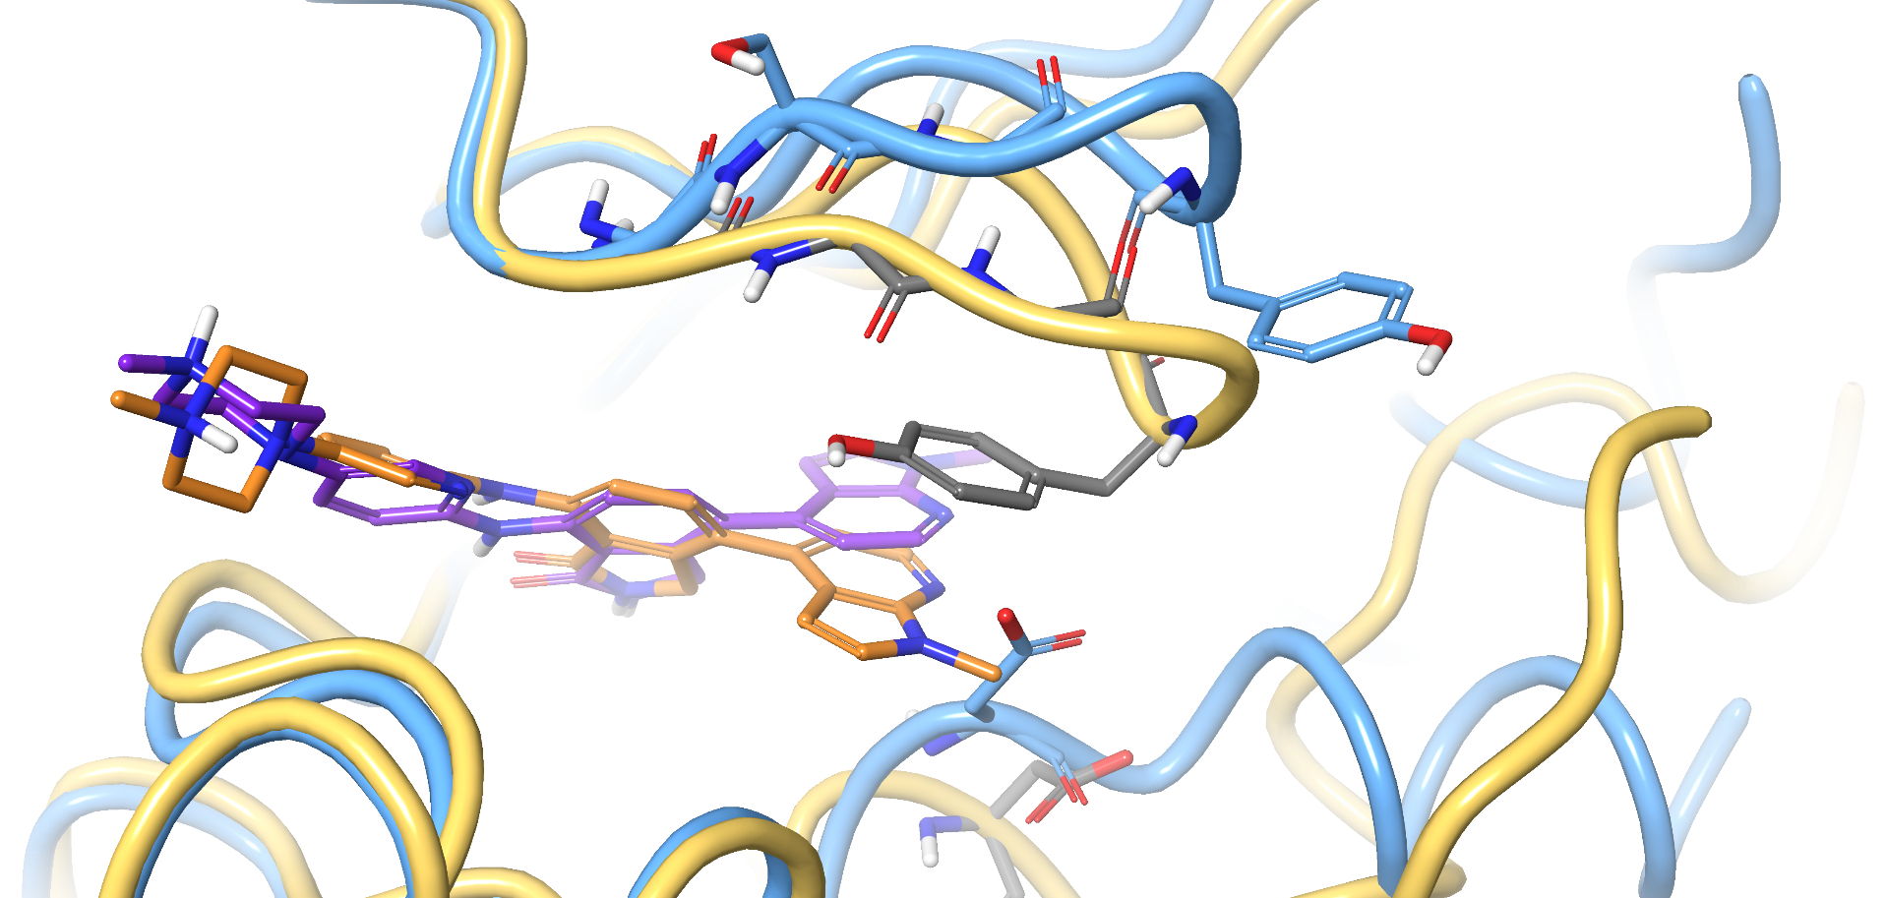
Structural Basis for GLK Selectivity
P-Loop confirmation affects orientation of identical residues Tyr 28 (HPK1 in the pocket) versus Tyr 27 (GLK away from pocket)
Gly-Gly-Gly HPK1 P-loop motif gives added flexibility over GLK with Gly-Ser-Gly
Compound 14
Caliper 1 mM ATP
HPK1 IC₅₀ = 1.4 nM
GLK IC₅₀ = 84 nM
Selectivity = 60x
Flexibility of HPK1 P-loop allows Tyr28 π-π interaction with bicyclic
Tyr27 for GLK is orientated away from the pocked and no interactions are present with 14
GLK Tyr27
HPK1 Tyr28
GLK Asp154
Conventional DFG Asp position as observed in GLK not compatible with ligand out orientation and needs to move for HPK1
HPK1 Asp155
HPK1 with bound Compound 14 (yellow ribbon, orange ligand)
GLK with bound Compound 14 (blue ribbon, purple ligand)
Notes:
Old Title: Nimbus X-Ray Structures Fully Enable Structure Based Potency & Selectivity Optimization

Slide 9
Identification of Potent and Selective C-1 Aryl Substituent
C1
Assay | 13 | 15 | 16 | 17 | 18 | 19 | 20 | 21
HPK1ª IC₅₀ (nM) | 2.6 | 4.2 | 1.8 | 0.7 | 3.6 | 2.2 | 0.9 | 0.5
GLK Selectivity^{b} | 46 | 127 | 175 | 439 | 269 | 91 | 180 | 152
Cell pSLP76 IC₅₀ (nM) | 116 | 101 | 1800 | 225 | 204 | 218 | 56 | 46
hPPB fu (%) | 1.8 | 1.5 | <1 | <1 | <1 | <1 | <1 | <1
ªBiochemical potency at 1 mM ATP; ^{b}1 mM ATP
Compounds are active in cell-based pSLP76 assay
High plasma protein binding: few compounds have a measurable free fraction in human PPB measurements
Compound 15 had the best balance of physical properties, GLK selectivity and cellular potency
  At 75 mpk, it showed only 4 hours coverage of pSLP76 IC₅₀
Notes:
Spend less time. Talk trends don’t stop on each data

Slide 10
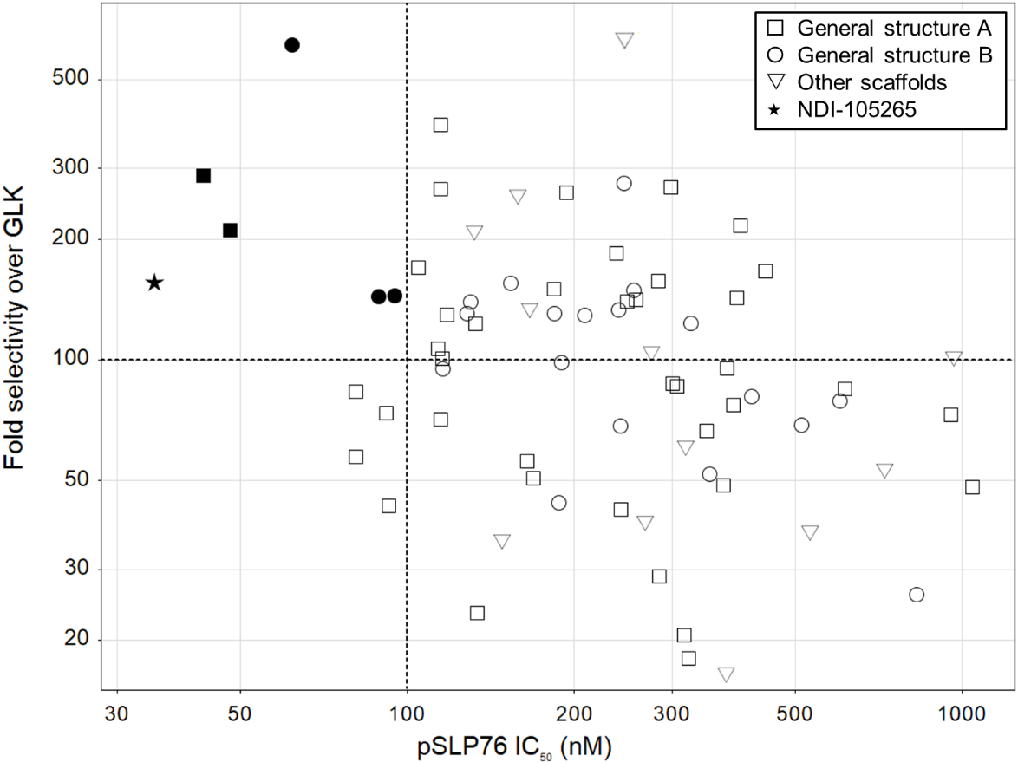
Identification of Potent and Selective Solvent Facing C-5’ Substituent
C-5’
Compound 22
22
A: X = CH₂
B: X = O
Compound 22 identified as a lead compound
  >100-fold selectivity against GLK and good potency in biochemical and pSLP76 assay
  In a mouse PO PK study at 75 mpk showed 24 hour coverage of pSLP76 IC₅₀

Slide 11
Early Frontrunner (Compound 22) Exhibited Suboptimal Predicted Human PK
Potent and selective HPK1 inhibitor
Assay | Compound 22 | Compound 22
HPK1 IC₅₀ 1mM ATP | 0.7 nM | 0.7 nM
HPK1 pSLP76 IC₅₀ | 31 nM | 31 nM
Selectivity assessment (fold selectivity @ [ 1 mM ATP])
GCK / MAP4K2 | 600
GLK / MAP4K3 | 130
HGK / MAP4K4 | 2800
KHS / MAP4K5 | 100
MINK | 2600
TNIK | 500
Assay | Compound 22
MDCK (x10⁻⁶ cm/s) A-B / EER | 52 / 15
Kinetic solubility (FeSSIF) | >200 µM
hHeps (mL/min/Kg) Clpred | < 8
Mouse Cl_{obs} (mL/min/Kg) (mHeps) | 11 (36)
Rat Cl_{obs} (mL/min/Kg) (rHeps) | 27 (26)
Dog Cl_{obs} (mL/min/Kg) (dHeps) | 18 (17)
hPPB (%) | 98.1
Rat Vss (L/kg) | 0.90
Mouse Vss (L/kg) | 0.50
Dog Vss (L/kg) | 1.6
Cl=7mL/min/kg
Vss=0.9L/kg,
hppb=1.9%
%F=30
CT-26 syngeneic mouse model 22 dosed at 75 mpk PO QD
Robust and statistically significant tumor growth inhibition(69%) observed with 16h coverage of pSLP76 IC₅₀
Predicted high dose high frequency in humans

Slide 12
Designing for Dose: Increased Volume of Distribution(Vd) and Half-life to Improve Predicted Human Dose
What parameters can we change to get reasonable predicted human dose?
Back to the drawing board
Assay | Target Profile | Phys Props
HPK1 IC₅₀ 1mM ATP (nM) | <1
HPK1 cell IC₅₀ (nM) | < 50
GLK selectivity fold | > 100
pK_{A} | > 7.5 | Basic amine
hPPB (fu) % | measurable | cLog P < 3
HLM Cl (mL/min/kg) | < 12
MDCK Permeability A-B (10⁻⁶ cm/s) | > 15 | HBD < 2
Volume of Distribution Vss L/kg | > 5 | pKA > 7.5
Amine substitution leads to AChE inhibition
X
Hinge Binder
AChE docking model shows amine substituent here will move away from the catalytic site and be tolerated
Substitution not tolerated
Polar groups tolerated

Slide 13
Medicinal Chemistry Strategy to ↑ Vd and T_{1/2}: Add Basic Amine while Maintaining Potency and Selectivity
5’
6’
Assay | 23 | 24 | 25 | Series 26 | Series 27
HPK1ª IC₅₀ (nM) | 2.4 | 336 | 174 | <10 | <10
GLK Selectivity^{b} | 498 | -- | -- | >100 | >100
AChE IC₅₀ (nM) | 1230 | 9950 | 2100 | <50 | >10000
ªBiochemical potency at 1 mM ATP; ^{b}1 mM ATP;
Structural analysis suggested the imidazopyridine group may accommodate polarity – but potency and AChE selectivity was suboptimal (compounds 23-25)
HPK1 potency was retained when the amine pointed towards solvent (substitution of the pyridyl)
The 6’ substituted amine series 27 maintained HPK1 potency and selectivity against AChE
  Further exploration at the 6’ position was pursued

Slide 14

Optimizing Phys Props in the Basic Series - Impact of AlogP-SP on Different Parameters
AlogP-SP sweet spot
1.5 - 2
hERG IC₅₀ >5 μM
Examples in this range - Poor hERG
C-linked C5
N-linked C5
Examples in this range – High hPPB
hPPB <99%
Series 2B – N-Linked
Examples in this range - Poor perm
MDCK A to B >10
(10⁻⁶cm/s)
C-linked C5
N-linked C5
AlogP-SP* used to establish correlations to ADME properties. To achieve all 3 parameters need to be in sweet spot
* cLogP surrogate from Schrödinger
Notes:
Start with conclusion to achieve all three parameters need to be in 1.5 – 2 AlogP-SP.

Slide 15
Identification of Development Candidate NDI-101150
R* =
6
Assay | 101150 | 28 | 29 | 30 | 31 | 32 | 33
HPK1ª/pSLP76 IC₅₀ (nM) | 0.7/42 | 1.3/154 | 0.6/134 | 0.8/300 | 0.4/18 | 0.8/151 | 0.7/32
GLK Selectivity^{b} | 377 | 523 | 518 | 288 | 258 | 265 | 429
MDCK WT P_{app, A-B}^{c} | 32 | 6 | 5 | 3 | 30 | 8 | 75
hHep Cl_{pred} (mL/min/kg) | 8 | 10 | 14 | 8 | 18 | 14 | 17
Dimethyl amine at C-6 shows best P_{app} and hHep Cl_{pred}
ªBiochemical potency at 1 mM ATP; ^{b}1 mM ATP; ^{c}10⁻⁶ cm/s ; * stereochemistry arbitrarily assigned
5’
R* =
Assay | 101150 | 34 | 35 | 36 | 37 | 38
HPK1ª/pSLP76 IC₅₀ (nM) | 0.7/42 | 0.9/88 | 0.9/114 | 2.1/74 | 0.5/176 | 1.1/540
GLK Selectivity^{b} | 377 | 469 | 613 | 256 | 1176 | 402
MDCK WT P_{app, A-B}^{c} | 32 | 19 | 8 | 8 | 9
hHep Cl_{pred} (mL/min/kg) | 8 | <8 | <9 | <9 | 12
hERG PC IC₅₀ (nM) | 2829 | 7218 | 12700 | 7712 | 1093
Rat PK Vss (L/kg)/Cl (mL/min/kg)/F% | 5/34/20 | 9/98/<1 | 17/82/4 | 23/73/<1
Low rat oral bioavailability could be driven by low permeability or high clearance
Notes:
Put a variety of amines at the 6’ position with pKa ranging from 7 to 10. NDI-101150 had an acceptable risk profile to move forward; All compounds in the desired AlogP-SP range; Spend less time on this slide. Just touch upon the lower table briefly. Some compounds had better hERG but not other profile. N(Me)2 interaction with Asp101.

Slide 16
NDI-101150: Development Compound Profile
HPK1 Assay | IC₅₀ (nM)
Caliper @ 1 mM ATP | 0.7
pSLP76 | 42
Kinase (Fold Selectivity)*
GCK/MAP4K2 | 8000
GLK/MAP4K3 | 377
HGK/MAP4K4 | 10740
KHS/MAP4K5 | 489
MINK/MAP4K6 | 10740
TNIK/MAP4K7 | 1336
c-SRC | 3630
FYN | 3110
LCK | 2143
SYK | 20000
TYK2 | 30000
Assay | NDI-101150
Cyp Inhibition | 1A2, 2B6, 3C8, 2C9, 2C19, 3A4M, 3A4T IC50 > 30 uM 2D6 IC50 = 17 uM No evidence of TDI at 50 uM
Cyp Induction | PXR activation assessed at 3/30uM no activation
hERG Manual PC IC₅₀ | 2800 nM
In the GLP in vivo telemetry study in conscious monkeys no effects on cardiovascular function (HR, BP, ECG parameters)
> 300-fold selectivity in 300+ kinase panel
4 hits in Eurofins panel. Secondary assays complete– no concerns.​
Assay | NDI-101150
Molecular Weight | 486.5
Log P (measured) | 2.6
Log D (measured) | 2.0
pKa (measured) | 8.9
Solubility (pH 7.4) | 140 uM
MDCK P_{app} (x10⁻⁶ cm/s) / ER | 32 / 0.7
* 1 mM ATP assay
Notes:
Focus on what you want to say no need to go through everything. Excellent selectivity profile.

Slide 17
NDI-101150: Suitable In Vivo Exposure and Clearance from Discovery PK Studies
In vivo |  |  |  |  | In vitro
Species | Cl (mL/min/kg) | V (L/kg) | Half life (hr) | F (%) | Microsomes (mL/min/kg) | Hepatocytes (mL/min/kg) | PPB (%)
Mouse | 30 | 1.9 | 1.1 | 50 | 61 | 84 | 80
Rat | 34 | 5.1 | 3 | 18-44 | 24 | 44 | 84
Monkey | 16 | 3.3 | 6.1 | 14-24 | 36 | 22 | 87
Dog | 43 | 13 | 6.8 | 33 | 26 | 24 | 73
Human | TBD | TBD | TBD | TBD | 12-13 | 7 | 75
Early dose projection for 16 h pSLP76 coverage
V = 6 L/kg, Cl = 7.2 mL/min/kg, t1/2 = 11 h
Notes:
No need for ivivc focus on Vd, F%, formulation help

Slide 18
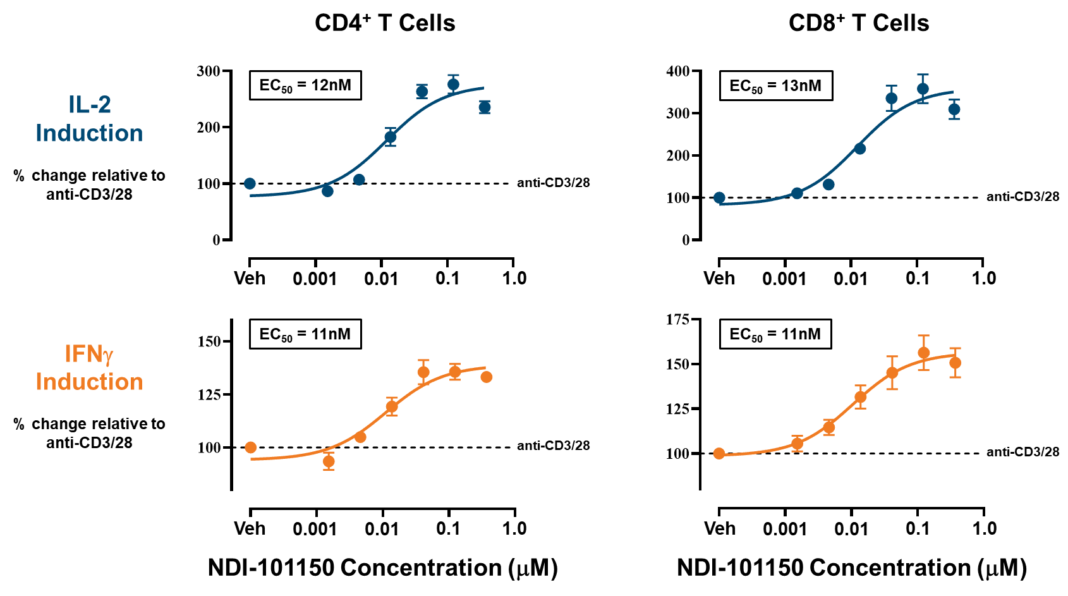
Nimbus HPK1 Inhibitor NDI-101150 Preclinical Biology
NDI-101150 mediates activation of not only T cells, but also B cells and dendritic cells
  In human T cell activation assays, NDI-101150 was able to enhance the activation of both CD4+ and CD8+ T cells by increasing levels of IL-2 and IFNg
  Enhances IgG secretion by B cells
  Enhances activation and antigen presentation in bone marrow derived dendritic cells
Notes:
Cytokine for B Cells IgG; Dendritic cells activate measure cytokine.

Slide 19
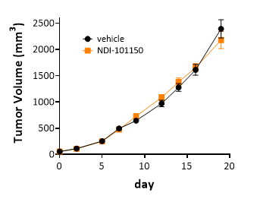
NDI-101150 Demonstrates Robust Efficacy in the EMT-6 Syngeneic Mouse Model, in an Immune-dependent Manner
Robust Efficacy & Durable Immune Memory in the Murine EMT6 Syngeneic Tumor Model
Vehicle
Naïve Animals
NDI-101150 75mpk/day, po showed 7 complete responses (CRs) of 10 mice
After rechallenge with tumor, NDI-101150 cured mice show complete tumor regression without any further dosing
NDI-101150
Tumor Rechallenged Animals
Compound
Washout
Period
No Efficacy Observed in EMT-6 Xenograft Model
Vehicle
NDI-101150
NDI-101150 75mpk/day, po did NOT induce tumor growth inhibition in a xenograft version of EMT6 showing that HPK1 inhibition is mediated through the animals immune system
Notes:
No need to explain the model

Slide 20
NDI-101150 is being investigated in a Phase 1/2 Clinical Trial
Phase 1/2 multicenter, open-label trial (NCT05128487) designed to assess NDI-101150 as a monotherapy (50-200 mg dose) and in combination with 200 mg pembrolizumab in the treatment of adults with advanced solid tumors
Primary objectives: recommended phase 2 dose(s) and maximum tolerated dose
Secondary objectives: safety, pharmacokinetic profiles, and preliminary antitumor activity
Preliminary results* presented at the 2024 ASCO Annual Meeting showed:
  Data from 44 patients in the dose escalation cohorts (n=38 on monotherapy, n=6 on combination therapy) and 15 patients in the dose expansion cohorts
  NDI-101150 was well-tolerated with overall acceptable safety profile
  NDI-101150 plasma concentrations increased in a near dose-proportional manner
  Steady-state plasma concentrations at all doses were sufficient to cover the pSLP76 IC50 for a duration consistent with preclinical efficacy modeling
  NDI-101150 showed an increase in activated CD8+ T cells and dendritic cell infiltration in on-treatment patient biopsies compared to archival biopsies, consistent with nonclinical studies of NDI-101150 showing immune cell infiltration and robust anti-tumor activity in murine syngeneic tumor models
  Treatment with NDI-101150 monotherapy was associated with clinical benefit in five out of 30 (16.7%) response-evaluable patients, including one complete response, one partial response, and three cases of durable stable disease
Notes:
Focus on only important points on each slide.

Slide 21
Preliminary Monotherapy Pharmacodynamic and Pharmacokinetic Results from an Ongoing Phase 1a Dose Escalation Study of NDI-101150
Mean concentration on Cycle 1 Day 1, Day 15 & Cycle 2 Day 1
Change in percentage pSLP76 from baseline to Cycle 1 Day 15
NDI-101150 showed a dose-dependent increase in plasma concentration and accumulation at steady state, with pSLP76 inhibited at all doses
  Nearly dose proportional increases in mean exposure was observed on Cycle 1 Day 1
  Steady state was achieved by Cycle 1 Day 15
  Accumulation was observed between Cycle 1 and Cycle 2
  PD results demonstrated >50% reduction of pSLP76 (proposed therapeutic target) in each cohort by Cycle 1 Day 15
Notes:
Data from monotherapy in Phase 1a. Left plot shows dose dependent increase in exposure 50 to 100 to 150 mg. Steady state by day 15. Some accumulation in cycle 2. Right plot 50% reduction in pslp76 at all doses by day 15.

Slide 22
Summary
Knowledge-based hit generation approach was the most successful of four hit generation campaigns
SBDD applied to optimize both potency and selectivity
  Multiple proprietary crystal structures of HPK1, GLK and KHS obtained
    Co-crystal structures of near neighbor kinases applied to optimize selectivity
  Protein/ligand structures guided SBDD and FEP despite highly flexible protein
  Off-target undesired activity, e.g. AChE, hERG removed by modeling strategy
Potent and Selective HPK1 inhibitors were optimized for their predicted human dose
  Addition of basic groups to inhibitors to improve phys props (↑ volume of distribution, ↑ solubility, ↓ Cl_{int}) to improve predicted human dose and half life
NDI-101150 was identified as a potent HPK1 inhibitor which showed
  High selectivity both within the MAP4K family and in the wider kinome
  Activation of T cells, B cells and dendritic cells, to mount a robust anti-tumor response
  Robust preclinical activity, both as a monotherapy and with synergistic efficacy in CPI combinations
NDI-101150 is currently being investigated in a Phase 1/2 clinical trial (NCT05128487)
  NDI-101150 treatment associated with activated CD8+ T cells and dendritic cell infiltration in tumors
  Treatment with NDI-101150 monotherapy resulted in preliminary evidence of clinical benefit and an acceptable safety profile

Slide 23



Acknowledgements
Beth Browning
Samantha Carreiro
David Ciccone
Alan Collis
Scott Edmondson
Abbas Kazimi
Christine Loh
Joshua McElwee
Peter Tummino
Lewis Whitehead
Mark Ashwell
Byron DeLaBarre
Jennifer Rocnick
Ron Wester
Anita Scheuber
Bhaskar Srivastava
Scott Daigle
Scott Boiko
Amanda Hoerres
Frank G Basile
Xinyan Zhang
Patricia Fraser
Sue Dasan
Daria Chabas
Mark Carlson
Denise Levasseur
Hyesun Oh
Avinash Phadke
Vinayak Hosagrahara
Gabby Poirier
Pavan Kumar
Jeff Conant
Cindy Fung
Steven Albanese
Asela Chandrasinghe
Alexandre Cote
Eric Feyfant
Jeremy Greenwood
Abba Leffler
Dan Severance
Shawn Watts
Anya Avrutskaya
Matthew Benson
Mike Briggs
Bethany Bowers
Thi Bui
Erica Goldsmith
Victoria Hughes
Marieke Lamers
Vad Lazari
Phil Leonard
Ian Linney
Natalie Lyall-Varnas
Sarah L Martin
Anthony Middleton
Nick Pearson
Adam Ringrose
Stuart Ward
Yvonne Walker
Ben Whittaker
Douglas Weitzel
Grant Wishart
Eddie Wood
Benno Van El

